Slide 1

Entering Grade 10
Course Selection
2020-21
Counsellor Presentation

Slide 2
Grade 10 Compulsory Courses
Geometry Measurement and Finance 10 or
FI Geometry Measurement and Finance 10
English 10
Social Studies 10 or FI Social Studies 10
Science 10 or FI Science 10
French 10 or FILA 10 (early or late immersion) or Wolastoqey 10
PDCP
All Grade 9 courses are prerequisites for same subject grade 10 courses

Slide 3
Elective Credit Courses
You Choose either Numbers Relations & Functions 10 /FI Numbers Relations and Functions 10 OR an alternate credit.
Numbers Relations and Functions 10
FI Numbers Relations and Functions 10
Fine Arts 110
Dramatic Arts 110
PIF 110
FILA 110: Grade 3 Entry
Grade 6 Entry
Entrepreneurship 110
Hospitality and Tourism 110
Human Physiology 110
Writing 110
OR

Slide 4
Numbers Relations & Functions 10
Numbers, Relations, Functions 10
Prerequisites: Math 9A & 9B
This course is the prerequisite course for the Foundations and Pre-Calculus Pathways and sets the foundation for topics in relations and functions. Topics include linear relations and functions, polynomials, radicals and exponents. Students entering this course should have a 70% or higher in Math 9B.
For a description of the other electives please refer to the Parent Information Document for Grade 9 to 10 students which has been uploaded on the School Website.

Slide 5
Two math credits are needed for GRADUATION REQUIREMENTS BEGINNING WITH THE GRAD CLASS OF 2023
Numbers Relations and Functions (NRF) 10 counts as a credit; if students don’t select NRF 10 they need to select another credit course. (Options listed on slide 3)
There are a variety of ways to obtain the two math credits for graduation:
  NRF 10 + Financial Workplace 110
  NRF 10 + Foundations 110
  Financial Workplace 110 + MATH 1208 NBCC Foundations (Formerly Financial Workplace 120)
NRF 10 can be taken in English or Immersion.

Slide 6
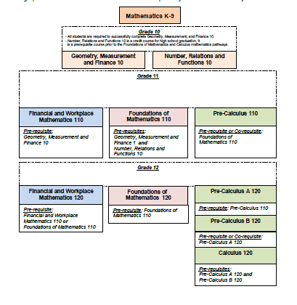
High School Math Pathway
Notes:
GMF & NRF are prerequisites for Foundations Math 110
GMF is a prerequisite for Financial and Workplace Math 110
Foundations Math 110 is prerequisite for Pre-Calculus 110
Pre-Calculus 110 is prerequisite for Pre-Calculus 12A and 12B
Knowing which math pathway to take is dependent on your math strengths and your post-secondary plans

Slide 7
Post Secondary Math Requirements
Students and parents should research post-secondary requirements for programs of interest. Requirements vary from school to school.
Financial Workplace 110-Entrance into a Bachelor of Arts, Fine Arts, Social Sciences and various college programs that don’t require further math.
NRF 10, Foundations 110 & 120-Bachelor of Nursing, BBA at some universities, such as Acadia, SMU (not UNB)
NRF 10, Foundations 110, Pre-Cal 110, 120A, 120B-Bachelor of Science and all Science related degrees, Comp. Science, Engineering, Some BBA programs (UNB)
Math 1208 This math, taken in grade 12 at LHHS, will provide credit for both high school and NBCC first year math for many NBCC trades’ programs; -see counsellor for list of programs this applies to. No NRF needed for this. GMF 10 is taken then Financial 110 and then Math 1208.

Slide 8
Grade 10 electives
You must choose two electives and one alternate
Broad Based Technology 10
Intro to Applied Tech 110
Phys Ed. 10
Visual Art 10
Music 10 – Guitar
      Choral
      Keyboard
      Instrumental

Slide 9
Course Selection Process
Talk to your parents/teachers to help guide your decisions
Make sure you think about your choices carefully. You will not have the opportunity to change your mind in the fall, unless it affects post secondary plans.
Pass in your completed Course selection form to your homeroom teacher by March 12th

